Slide 1
PERSEVEX NLP INTERNSHIP · AUGUST 2026
BrandPulse AI
Twitter Sentiment Analysis
Presented by: Sisira T S
Domain: Artificial Intelligence

Slide 2
Problem Statement
Objective
Marketing teams are overwhelmed by tweet volume and have no scalable way to gauge brand sentiment in real time.
Build an ML pipeline that classifies tweets as Positive, Negative, or Neutral.
Manual monitoring delays response to genuine service failures buried in the noise.
Compare a Classical NLP model (TF-IDF + Logistic Regression) against a Deep Learning model (Bidirectional LSTM).
Existing approaches can't separate urgent complaints from neutral or positive chatter fast enough to act on.
Evaluate both with Accuracy, Precision, Recall, F1-score, and confusion matrices.
Interpret predictions to explain which words drive each sentiment class.
Deploy both models through an interactive Streamlit dashboard.
2

Slide 3
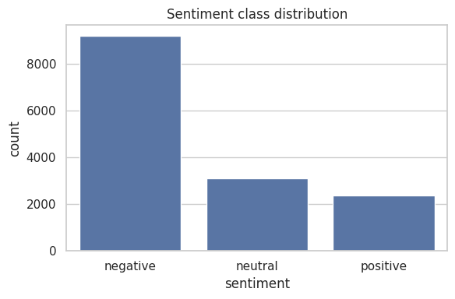
Twitter US Airline Sentiment Dataset
SOURCE
TOTAL RECORDS
AIRLINES COVERED
TARGET VARIABLE
Crowdflower (Feb 2015)
14,640 tweets
6 major US airlines
Sentiment - Negative / Neutral / Positive
Class Distribution
Key Predictive Fields
text -raw tweet content
Airline sentiment - target label
airline - which of 6 airlines
negativereason - stated complaint reason
62.7% negative, 21.2% neutral, 16.1% positive a heavily imbalanced dataset accounted for during training and evaluation.
3

Slide 4
Methodology
1
Data Collection
2
Text Cleaning
3
Exploratory Analysis
Twitter US Airline Sentiment dataset 14,640 real tweets.
Strip URLs/mentions, expand hashtags, lemmatize, remove stopwords (keep negations).
Class balance, word frequency, per-class vocabulary patterns.
4
Feature Engineering
5
Model Training
6
Evaluation
TF-IDF (unigrams+bigrams) for classical; tokenize + pad for deep learning.
TF-IDF + Logistic Regression, and an Embedding + BiLSTM network.
Accuracy, Precision, Recall, F1, confusion matrices on a shared test set.
7
Error Analysis
8
Interpretability
9
Deployment
Catalogue misclassifications; identify most-confused class pairs.
Rank top words driving each sentiment class from model coefficients.
Streamlit dashboard: predict, batch analyze, live-stream demo, compare models.
4

Slide 5
Data Preprocessing
Noise Removal
Normalization
Negation-Safe Stopwords
Lemmatization
URLs, @mentions stripped via regex; hashtags expanded to plain words rather than discarded.
Lowercased, HTML entities and non-alphabetic characters removed.
Stopwords removed, but "not", "no", "never" kept "not good" must stay distinct from "good".
NLTK WordNetLemmatizer normalizes word forms ("running" → "run").
Train / Test Split — 80 / 20 (Stratified)
80%
20%
11,695 training tweets · 2,924 held-out test tweets · random_state = 42, identical for both models
Train
Test
5

Slide 6
Exploratory Data Analysis
Class Imbalance
Negative tweets (62.7%) dominate typical for customer-service data. Handled with class-weight balancing and macro-averaged metrics.
Complaint Vocabulary
"delayed", "cancelled", "hour", "bag", "hold" dominate negative tweets — mostly operational failures.
Gratitude Vocabulary
"thanks", "great", "awesome", "love" dominate positive tweets quantified later via model coefficients .
6

Slide 7
Machine Learning Models
Classical NLP
Deep Learning
TF-IDF + Logistic Regression
Bidirectional LSTM
Unigrams + bigrams TF-IDF vectors feed a class-weight-balanced multinomial Logistic Regression classifier.
Embedding(128) → BiLSTM(64) → Dense(64, ReLU) → Dropout(0.3) → Dense(3, Softmax), trained with early stopping (patience=2).
Fast to train (~2 sec)
Reads word order & context
Small model (~0.9 MB)
Best raw accuracy (80.0%)
Directly interpretable coefficients
Larger model (~32 MB)
Strong, defensible baseline
Slower to train (~100 sec)
7

Slide 8
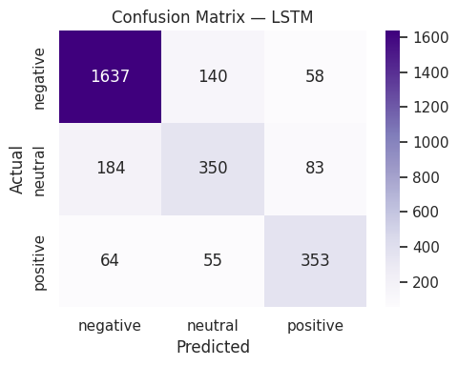
Results & Model Comparison
Model | Accuracy | Macro F1 | Weighted F1
Logistic Regression | 77.4% | 0.72 | 0.78
Bidirectional LSTM | 80.0% | 0.74 | 0.80
Why BiLSTM wins
• Learns word order
• Captures negation scope
• +2.6 pts accuracy
• Best negative-tweet recall (0.89)
Trade-off: ~50x longer training, ~35x larger model, lower interpretability than Logistic Regression.
Confusion matrix - BiLSTM (best model)
8

Slide 9
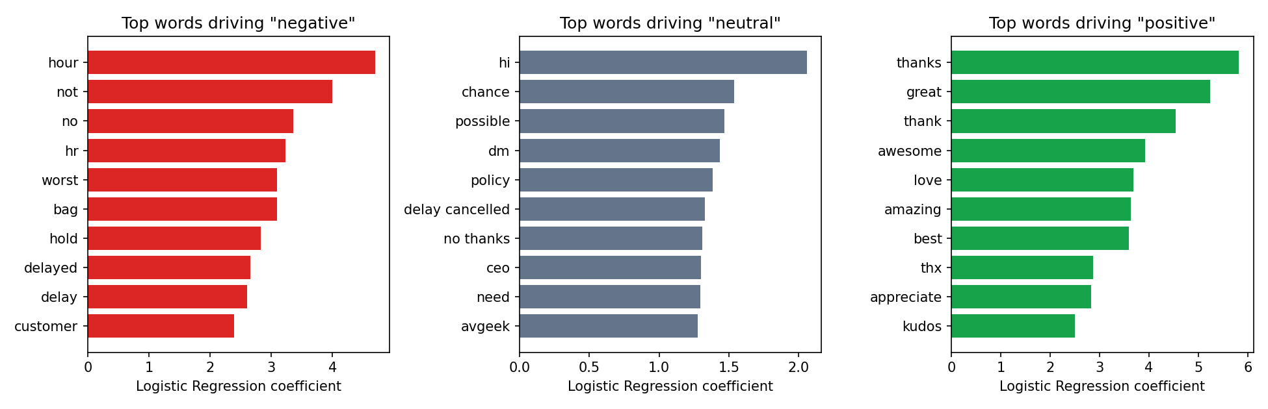
Model Interpretability
Because Logistic Regression assigns each TF-IDF word a signed coefficient per class, the top-weighted words for a class can be read directly as "what the model learned drives this sentiment" the classical-NLP equivalent of a SHAP summary plot.
Key Insight
Negation words ("not", "no") rank high for negative sentiment confirming the preprocessing decision to keep negations was correct.
9

Slide 10
Error Analysis
Most Confused Classes
Real Misclassified Examples
Neutral → Negative
"@JetBlue actually flight 1089 not 1098"
Actual: Neutral → Predicted: Negative (80.2%)
Neutral → Positive
"@AmericanAir Thank you, you too!"
Positive → Neutral
Actual: Neutral → Predicted: Positive (97.5%)
Neutral sentiment is the hardest class for both models (F1 ≈ 0.60) short, factual, or question-style tweets share vocabulary with genuine complaints or lack sentiment cues altogether.
"@AmericanAir I wish I could remember all of their names!"
Actual: Positive → Predicted: Neutral (50.1%, low confidence)
10

Slide 11
Business Recommendations
Conclusion
Default to Logistic Regression for production monitoring fast, cheap, and its predictions can be explained in plain language.
Delivered an end-to-end NLP pipeline: cleaning, EDA, dual-model training, evaluation, error analysis, interpretability, and dashboard deployment.
Offer BiLSTM as an optional "high-accuracy" mode for periodic deep-dive reports.
BiLSTM achieved the best raw performance (80.0% accuracy); Logistic Regression remains highly competitive given its speed, size, and interpretability.
Route low-confidence predictions to a human reviewer instead of auto-classifying.
Neutral sentiment is the shared limitation of both approaches a direction for future work, not a flaw of either model.
Treat spikes in "delayed" / "cancelled" / "luggage" negative tweets as an early operational-issue signal.
The BrandPulse AI dashboard gives a marketing team both the tool and the transparency needed to trust and act on its output.
Don't treat neutral predictions as "no action needed" without spot-checking.
11

